Slide 1
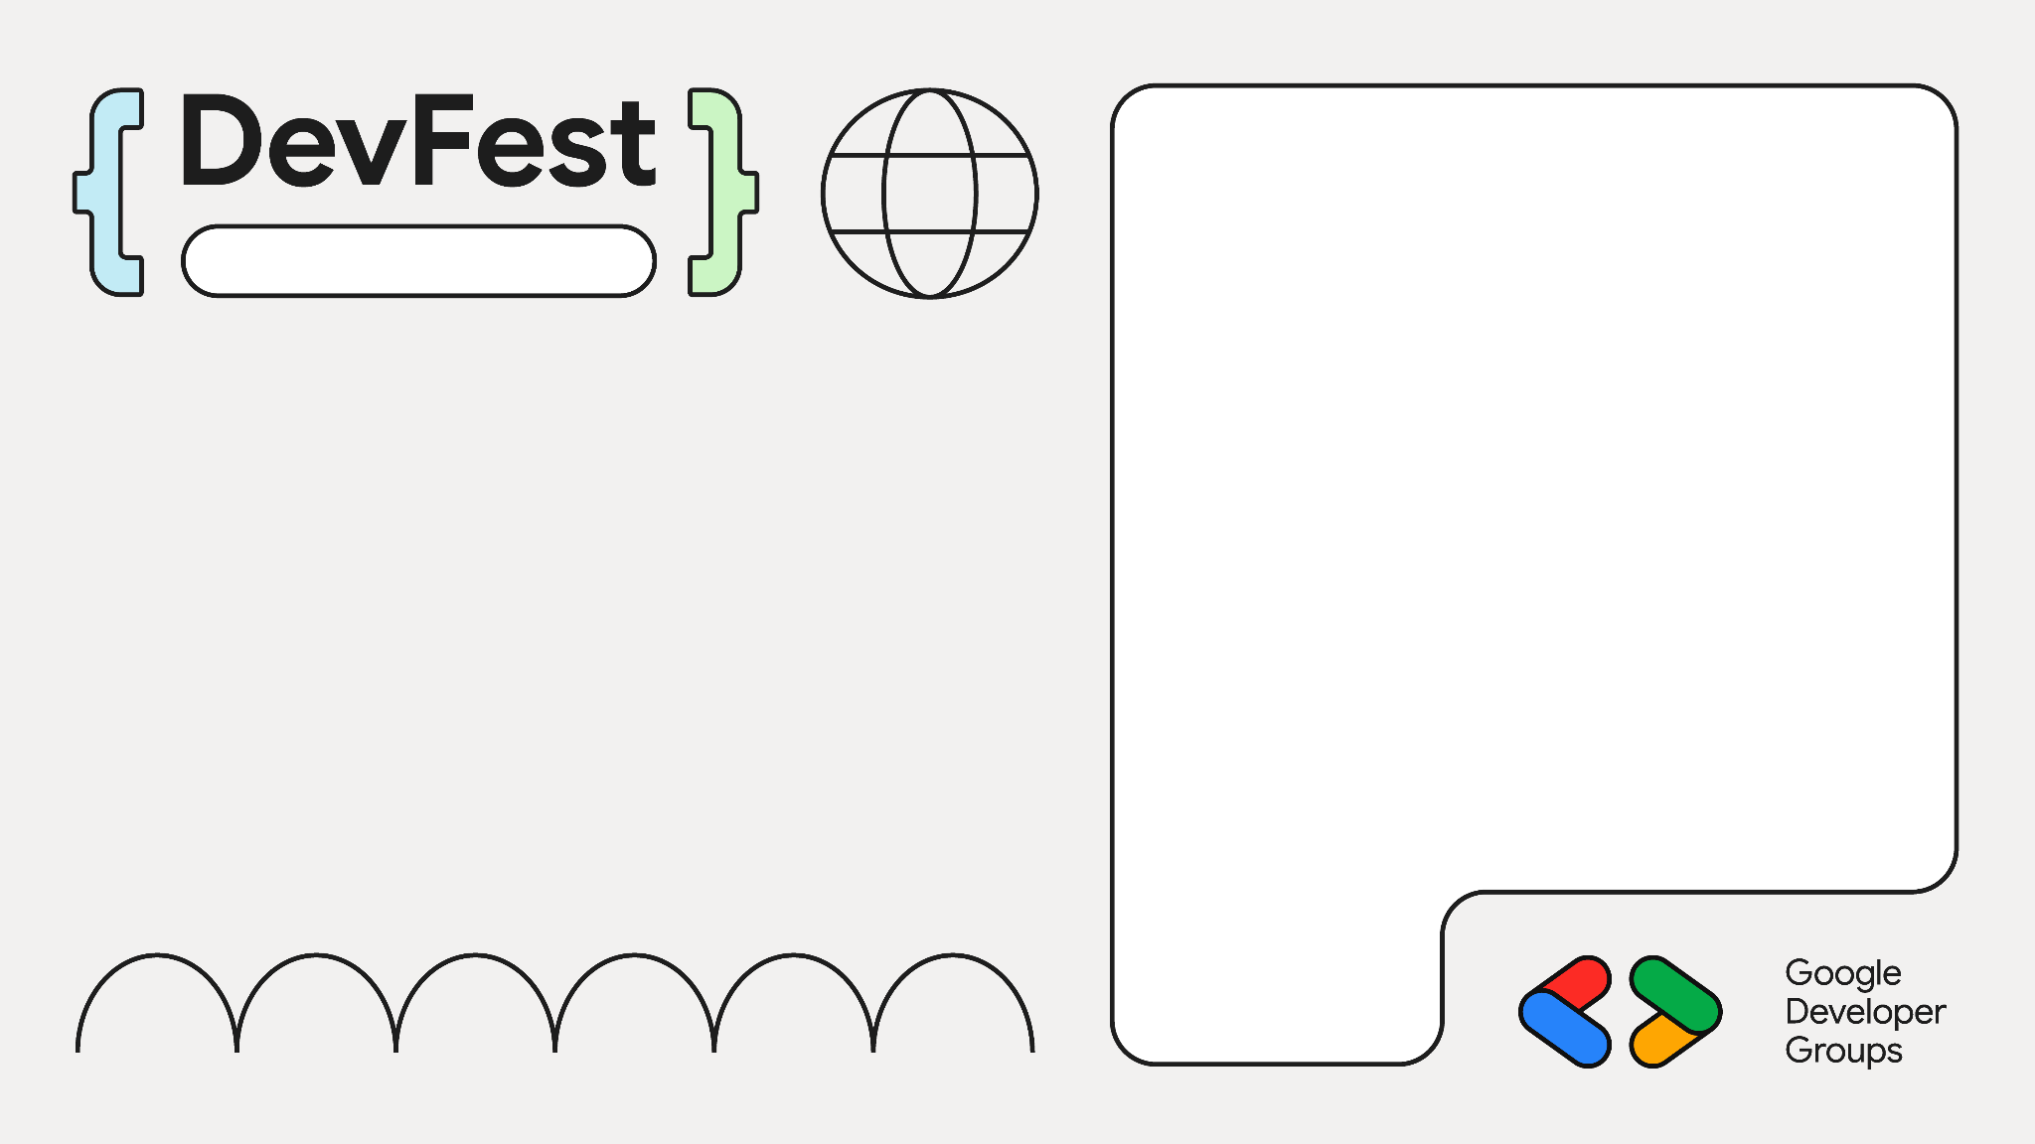

Build A ChatBot With RAG & Gemini
Sharjah
Rohan Mitra & Omar Gouda

Slide 2
What is RAG Architecture?
Retrieval – Augmented Generation
Retriever: Finds and retrieves the most relevant documents or knowledge from a corpus
Generator (LLM): Uses the retrieved information as context to generate accurate, fact-based responses.
Answer questions more reliably and with additional info

Slide 3
The Need For RAG
LLM limitations
Knowledge cutoff and static information
Hallucinations
Memory constraints
Lack of domain specific knowledge
RAG Provides
Real-time information
Grounding responses
Domain expertise
Combines the fluent conversation abilities of LLMs with real-time factual accuracy

Slide 4
Case Study
You work for Cymbal Bikes – a bike mechanics shop
Offers services like brake repair, chain replacement, etc
You have been tasked with building a chatbot for customers to get suggestions on your products, and identify which products they want
You’re going to do this with a RAG Architecture

Slide 5
RAG Pipeline
User Question
Document Retriever
Prompt Creator
LLM Model
Stream To User

Slide 6
User Question
User Question
User sends a question to the ChatBot
App has some preprocessing (and moderation) to question
Send response immediately incase of moderation
Cymbal Bikes: “How much does it cost to repair a gear and what all does it include, at Cymbal Bikes?”

Slide 7
RAG Pipeline
User Question
Document Retriever
Prompt Creator
LLM Model
Stream To User

Slide 8
Document Fetcher
Document Retriever
Identify documents with possibly relevant info
Create VectorDB
Chunk documents, embed the text, and store meta-data to allow filtering
Group similar documents into indicies or partitions
Eg: Elastic Search, Pinecone, Marqo, Qdrant
Query DB using user intent (embedding) + filters (if any)

Slide 9
Document Fetcher
Document Retriever: G-Electronics
Store each relevant document in an index
Can have different indices for different types of information
Service costing index, store policies index, FAQ index, etc
Each item’s description is embedded using a sentence encoder and the output vector is stored
Meta-data about each item are stored with the item’s listing for filtering (if applicable)

Slide 10
Document Fetcher
Document Retriever
Index with Chunked Documents
Document 1 Embedding Vector
“How much does it cost to repair a gear and what all does it include, at Cymbal Bikes?”
Document 2 Embedding Vector
Document 3 Embedding Vector
.
.
.
.
Sentence Embedding Model
Cosine Similarity
Question Embedding Vector
Document n Embedding Vector

Slide 11
RAG Pipeline
User Question
Document Retriever
Prompt Creator
LLM Model
Stream To User

Slide 12
Prompt Creator
Prompt Creator
Use the fetched documents to create a prompt dynamically
The prompt will be sent directly to the LLM for generation
Possible prompt template:
Objective of the LLM
Background about information source
Sections for different types of information given to the LLM
User question and any additional instructions

Slide 13
RAG Pipeline
User Question
Document Retriever
Prompt Creator
LLM Model
Stream To User

Slide 14
LLM Model
LLM Model
Send the prompt to the LLM model [along with message history]
Can use frameworks like LangChain, LLamaIndex, etc
Send request to LLM (Gemini, Gemma, GPT 4o, local hosted LLM, etc)

Slide 15
RAG Pipeline
User Question
Document Retriever
Prompt Creator
LLM Model
Stream To User

Slide 16
Stream To User
Stream Response
Set up streaming response (FastAPI has StreamingReponse class)
Intercept each chunk of text output by LLM for moderation
Log interactions to cloud – Prepare object to be logged

Slide 17

Document Fetcher
Let’s Code!
Copy Colab Notebook from: https://shorturl.at/f0kj7
Get Gemini Access
Visit: https://trygcp.dev/e/build-ai-SHA01
Log in with Google – Accept T&C
Download pdfs
Create Index with embeddings of chunked documents
Prompt generation function
Main RAG function
Use a basic UI for chat

Slide 18




Thank You!
Dubai
https://github.com/ro1406/rag-with-gemini/
https://www.linkedin.com/in/rohan-mitra14/
https://www.linkedin.com/in/ogouda/
https://github.com/ro1406
https://github.com/ogouda

